Slide 1



You2.0 – Beyond Tracking, Into Becoming.
Jaypee University of Information Technology
Department of Computer Science and Engineering and Information Technology
Major Project - I (18B19CI791) | AY 2025-26
Mid-Term Evaluation | Sept 29 – Oct 03, 2025.
Group No.: 71
Team Member (s)
Aashi Gupta (221030140)
Ishleen Kaur (22130249)
Lakshay Malik (221030022)
Supervisor
Mr. Kuntal Sarkar
Assistant Professor (Contractual)
CS/IT Department

Slide 2
Outline
Introduction
Problem Statement
Objectives
Literature Review
Work Plan after Mid-Term Evaluation
Project Design
Tools, Technologies and Languages
Dataset
Implementation
Results
Key Learnings
Project Plan
Work Contribution and Attendance
Supervisor Interactions
References

Slide 3
Introduction
Challenges in Modern Lifestyle
Poor eating habits, prolonged sitting, irregular sleep, and high stress
Rising lifestyle disorders: Obesity, Diabetes, Hypertension
Limitations of Current Fitness Apps/Devices
Focus mainly on steps or heart rate
Provide generic advice
Often costly and less engaging
Our Solution: You2.0 – AI-Powered Lifestyle & Wellness Tracker
Goes beyond tracking - focuses on transformation
Uses human logging + sensor-based tracking for holistic activity data
Employs machine learning to detect risks & provide personalized, real-time recommendations
Key Features
Proactive health insights
Gamified habit tracking
Intelligent reminders to sustain lifestyle changes

Slide 4
Problem Statement
People frequently find it difficult to lead balanced lives in today's fast-paced world because of erratic sleep patterns, unhealthy eating patterns, extended periods of inactivity, and poor eating habits. These elements play a significant role in the development of lifestyle-related conditions like diabetes, obesity, hypertension, and chronic stress, which are now among the most urgent worldwide health issues. The World Health Organization reports that non-communicable diseases brought on by unhealthy lifestyle choices are responsible for a sizable percentage of annual premature deaths, and this number is still rising. Despite increased awareness, the majority of people do not regularly monitor or assess their daily routines. Even seemingly simple tasks like keeping track of water intake, keeping an eye on the quality of sleep, or cutting back on inactivity are frequently disregarded, which can have long-term health effects that could be avoided with prompt intervention.

Slide 5
Objectives
To create a system that records lifestyle data (diet, sleep, physical activity, hydration, and mood) using manual or sensor-based inputs.
To develop and implement machine learning models that assess data and forecast potential health hazards (for example, obesity, stress, and diabetes).
To encourage healthy habits, offer individualized, real-time suggestions and gamified habit tracking.
To incorporate customized alerts and reminders that encourage people to make better choices all day long.
To provide an intuitive mobile interface that makes tracking, data entry, and visualization fun and easy.
To give consumers weekly or monthly reports with trend analysis and data-driven insights so they can recognize long-term trends in their lifestyle.

Slide 6
Literature Review
S. No. | Author & Paper Title [Citation] | Journal/ Conference (Year) | Tools/ Techniques/ Dataset | Key Findings/ Results | Limitations/ Gaps Identified
1. | Chiam et al. – Co-Pilot for Health Personalized Algorithmic AI Nudging to Improve Health Outcomes[1] | BMJ Open (2024) | Wearables + AI nudging system; large-scale intervention (84,764 participants) | Increased daily steps by ~6.17% and MVPA by ~7.61% with AI nudges vs control | Limited to physical activity outcomes; does not cover diet, stress, or holistic wellness
2. | JMIR Cardio – AI-Based, Autonomous, Digital Health Intervention Using Precise Lifestyle Guidance on Blood Pressure in Adults With Hypertension[2] | JMIR Cardio (2024) | BP monitor + wearable tracker + questionnaires + personalized ML models | Improved blood pressure control using AI-driven personalized guidance | .Non-randomized single-arm trial; results may lack generalizability
3. | Stolfi et al. – Use of Non-Invasive Parameters and Machine Learning Algorithms for Predicting Future Risk of Type 2 Diabetes[3] | BMC Bioinformatics (2020) | ML models using non-invasive lifestyle & clinical data | Successfully predicted diabetes risk using ML | Dataset limited in diversity; model may not generalize
4. | Patra et al. – Personal Goals, User Engagement, and Meal Adherence within a Personalised AI-Based Mobile Application for Nutrition and Physical Activity[4] | MDPI Life (2024) | AI-based nutrition & activity mobile app; engagement tracking | Personalized goal-setting improved user engagement and meal adherence | Study limited to short-term engagement; scalability not tested

Slide 7
Literature Review (cont…)
S. No. | Author & Paper Title [Citation] | Journal/ Conference (Year) | Tools/ Techniques/ Dataset | Key Findings/ Results | Limitations/ Gaps Identified
5. | Meta-analysis-The Effectiveness of Gamification in Changing Health-Related Behaviors: Systematic Review & Meta-analysis [5] | Systematic Review (2024) | Review & meta-analysis of gamification studie | Gamification increases engagement and improves outcomes like step counts | Many studies lacked long-term evaluation; focus mostly on physical activity
6. | JMIR mHealth – Applying AI in the Context of the Association Between Device-Based Assessment of Physical Activity and Mental Health: Systematic Review [6] | JMIR mHealth (2025) | Review of device-measured activity + AI models | AI can link physical activity patterns with mental health insights | Few longitudinal studies; lack of standardized datasets
7. | Straczkiewicz et al. - A systematic review of smartphone-based human activity recognition methods for health research [7] | npj Digital Medicine (2021) | Systematic review of 108 studies; Accelerometer, gyroscope, magnetometer sensors; Machine learning classifiers | Smartphones are well-suited for HAR research in health sciences. | Limited generalizability due to small sample sizes, homogeneous populations (primarily young adults), lack of diverse participants and activities.
8. | Kundu et al. - Smartphone based human activity recognition irrespective of usage behavior using deep learning technique [8] | Int. j. inf. tecnol. (2025) | CNN-based HAR framework; 2-D frequency domain images; Real-life data from 4 devices. | Proposed ensemble CNN model achieved 94% accuracy even when training and test devices were different. | Limited to 4 basic activities (sitting, standing, walking, jogging); small dataset with only 8 users.

Slide 8
Literature Review (cont…)
S. No. | Author & Paper Title [Citation] | Journal/ Conference (Year) | Tools/ Techniques/ Dataset | Key Findings/ Results | Limitations/ Gaps Identified
9. | Wang et al. - The Impact of Gamification-Induced Users' Feelings on the Continued Use of mHealth Apps: A Structural Equation Model With the Self-Determination Theory Approach [9] | J Med Internet Res (2021) | Structural Equation Model; Self-Determination Theory; Survey of 307 mHealth app users; PLS-SEM analysis | Gamification boosts intrinsic motivation through autonomy, competence, and relatedness, which in turn enhances satisfaction and continuance intention. | Limitations: small sample (307/2988), focus on Chinese users, limited gamification elements, and no long-term analysis.
10. | Hwang et al. - Research Trends on Mobile Mental Health Application for General Population: A Scoping Review [10] | Int. J. Environ. Res. Public Health (2021) | Scoping review of 14 studies; Scottish Intercollegiate Guidelines Network (SIGN) checklist | Mobile mental health apps reduced stress, depression, and anxiety, with mindful meditation apps most used (35.7%). | Only 14 studies, mostly therapy-based apps, with no long-term effect analysis.
11. | Almuqrin et al. - Smartphone apps for mental health: systematic review of the literature and five recommendations for clinical translation [11] | BMJ Open (2025) | Systematic review of 31 studies; RCTs only; Risk-of-bias assessment using RoB 2 tool | Smartphone apps were effective and acceptable for mental health treatment, self-monitoring, and multipurpose interventions. | Homogeneous sample of mainly middle-aged women, bias in 15 of 31 studies, and underrepresented groups.
12. | Gemesi et al. - Efficacy of an app-based multimodal lifestyle intervention on body weight in persons with obesity: results from a randomized controlled trial [12] | International Journal of Obesity (2024) | RCT with 168 participants; Oviva Direkt app; 12-week intervention with 12-week follow-up; BMI 30.0-40.0 kg/m² | ADHOC group lost 3.2±3.2 kg, maintained weight at 24 weeks, with app usage time linked to greater weight loss. | Single-center study in Munich, 12-week intervention, declining app usage, limited to moderate obesity (BMI 30–40).

Slide 9
Literature Review (cont…)
S. No. | Author & Paper Title [Citation] | Journal/ Conference (Year) | Tools/ Techniques/ Dataset | Key Findings/ Results | Limitations/ Gaps Identified
13. | Birhanu et al. - A mobile health application use among diabetes mellitus patients: a systematic review and meta-analysis [13] | Frontiers in Endocrinology (2024) | Meta-analysis of 13 studies; Random-effects model; Joanna Briggs Institute critical appraisal tool | Pooled prevalence of mHealth app use for diabetes self-management was 35%. Future interest in using apps was 57%. Significant heterogeneity observed (I²=97.7%). | Significant heterogeneity among studies; limited to developed countries only; cross-sectional design prevents causal conclusions; geographic disparities in app usage patterns.
14. | Hend S. Saad et al.- Employing of machine learning and wearable devices in healthcare system: tasks and challenges [14] | Neural Computing and Applications (2024) | No primary dataset; refers to reviewed datasets like MIT-BIH for arrhythmia | ML is crucial for remote patient monitoring, but faces significant challenges | Data reliability, security, high power consumption, and optimal model selection.
15. | Jon N. Bondevik et al.- A systematic review on food recommender systems [15] | Expert Systems with Applications (2024) | Identifies common datasets: Allrecipes, Food, and Yummly | Most FRS use Content-based filtering with ML; few are truly personalized. | Small datasets, regional data imbalance, and lack of robust real-world evaluation.
16. | Hafsa Habehh et al.- Machine Learning in Healthcare [16] | Current Genomics (2021) | ML algorithms (supervised, unsupervised, reinforcement) and their application in healthcare | Not a primary study; no dataset used. | ML has made substantial strides in predicting and identifying health emergencies and disease states

Slide 10
Literature Review (cont…)
S. No. | Author & Paper Title [Citation] | Journal/ Conference (Year) | Tools/ Techniques/ Dataset | Key Findings/ Results | Limitations/ Gaps Identified
17. | Logacjov A. et al.- A Machine Learning Model for Predicting Sleep and Wakefulness Based on Accelerometry, Skin Temperature and Contextual Information[17] | Nature and Science of Sleep (2024) | SVM, accelerometer + skin temp, 29 adults | Improved specificity (0.72) with high sensitivity (0.95). | Small dataset (29 participants), limited generalizability.
18. | Qi An et al.- A Comprehensive Review on Machine Learning in Healthcare Industry: Classification, Restrictions, Opportunities and Challenges [18] | Sensors( 2023) | discusses classification, anomaly detection, clustering | ML improves diagnosis, treatment, and data-driven healthcare insights; supervised methods excel in prediction tasks, unsupervised useful for clustering | Requires large labeled datasets, risk of bias, ethical/data privacy issues, limited interpretability of unsupervised models
19. | Tagne Poupi Theodore et al.- Applications of Artificial Intelligence, Machine Learning, and Deep Learning in Nutrition: A Systematic Review [19] | Nutrients (2024) | PRISMA + SLR, 2019–24 papers | AI aids dietary assessment, personalization, disease prediction. | No standard datasets, limited clinical trials.
20. | Raciel Yera et al.- A Systematic Review on Food Recommender Systems for Diabetic Patients [20] | IJERPH (2023) | PRISMA, RS methods, literature survey | Identified gaps in diabetic-focused recommender systems. | Few diabetes-specific RS, scarce real-world validation.

Slide 11
Work Done(after mid-term evaluation)
Food detection model
1. Data Handling
Imported both large-scale (Food-101) and small-scale (Indian-16) datasets
Cleaned directory structures
Verified all classes, image counts
2. Model Development
Implemented EfficientNet-B0 pipeline for Food-101
Implemented VGG16/ResNet50 fine-tuned models for Indian Food-16
Added:
Custom classifier layers
Dropout regularization
Learning rate scheduler
Mixed precision support
3. Training
Trained Efficien Net for 20 epochs, with early stopping
Monitored:
Train loss
Validation loss
Accuracy curves
Saved best-performing weights

Slide 12
Work Done(after mid-term evaluation)
Mood Recognition Model
1. Dataset & Preprocessing
Used FER-2013 (7 emotions).
Converted grayscale → RGB, resized to 224×224.
Applied augmentation: flip, rotation, color jitter.
Train/Test split: 70/30
2. Model Development
Implemented EfficientNet-B0 with modified classifier (7 classes).
Added dropout, weighted sampler, class-weighted loss, and LR scheduler (ReduceLROnPlateau).
Optimizer: Adam (1e-4).
3. Training & Evaluation
Trained for 25 epochs on GPU (Colab).
Achieved ~70% accuracy.
Monitored training loss, validation loss, and learning stability for each epoch.
Adjusted learning rate automatically using scheduler when progress slowed.
Applied early stopping to prevent overfitting and maintain generalization.
Generated confusion matrix, ROC curves & classification report.

Slide 13
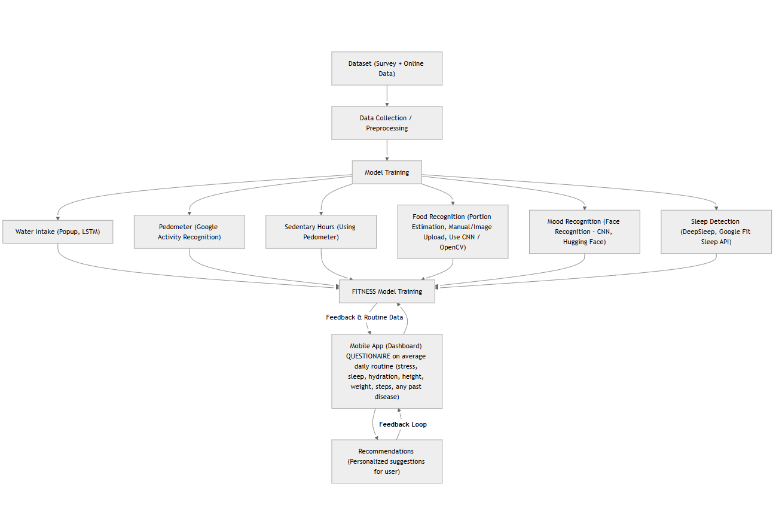
Project Design
System Architecture

Slide 14
Project Design (cont…)
1. Dataset & Preprocessing
• Sources: Survey data and online health datasets
• Techniques: Data cleaning, normalization, and feature extraction for consistent, high-quality inputs
2. Model Training Modules
• Water Intake: LSTM (time-series) with popup reminders
• Pedometer Data: CNN / LSTM or Google Activity Recognition API
• Sedentary Hours: Derived from pedometer data with threshold-based classification
• Food Recognition: CNN + OpenCV for portion estimation (with optional manual correction)
• Mood Recognition: CNN + OpenCV (face detection + mood recognition).
• Sleep Detection: Deep Sleep framework /Google Fit Sleep API
3. Integrated Fitness Model Training
• Module Integration: Combines all trained modules into a unified fitness model
• Learning Approach: Ensemble learning (stacked/weighted models) for robust lifestyle prediction and health insights
4. Mobile App Dashboard
• Daily Questionnaire: Collects user inputs (stress, sleep, hydration, weight, steps, medical history)
• Feedback Loop: Personalized alerts and adaptive recommendations (e.g., “Low hydration,” “Excessive sitting,” “Poor . sleep quality”)

Slide 15
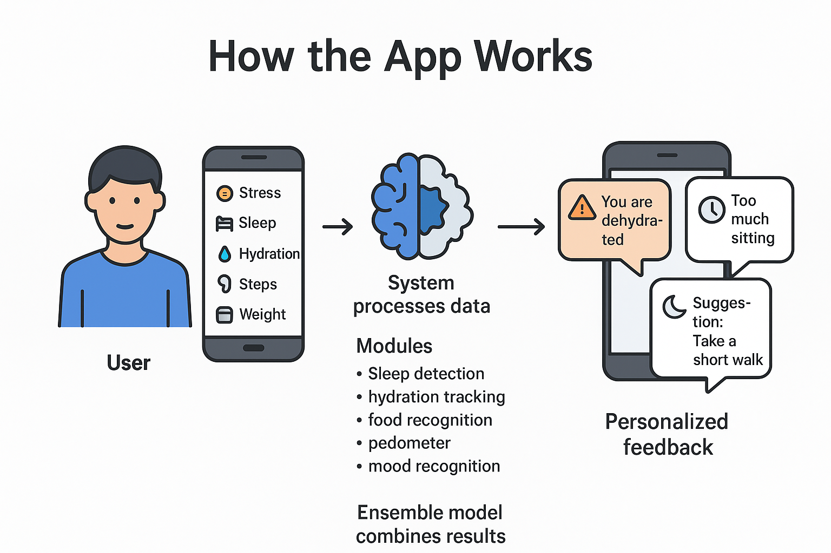
Project Design (cont…)

Slide 16
Tools, Technologies and Languages
1. Programming Languages:
JavaScript / TypeScript
Python
SQL
2. Technologies:
React Native 0.76 - mobile app development
Node.js 20 LTS + Express.js 4.21 - backend APIs
MongoDB Atlas 7.0 + Mongoose 8.6 - NoSQL database
JWT Authentication (jsonwebtoken 9.0.2) - secure login
Firebase Cloud Messaging v12.0 / OneSignal 5.0 - push notifications
TensorFlow 2.16 / Keras 3.4/ PyTorch - LSTM, CNN, DeepSleep framework
Scikit-learn 1.5 - baseline ML models, ensemble learning
Hugging Face Transformers 4.44 - mood detection (text/emotion)
OpenCV 4.10 - food recognition & portion estimation
Google Fit API - step count & sleep tracking (alternative to sensors)
GitHub - version control

Slide 17
Tools, Technologies and Languages (cont…)
3. Tools
pandas 2.2, numpy 1.26 → dataset preprocessing & feature extraction
Matplotlib 3.9 / Seaborn 0.13 → visualizations
Draw.io → architecture diagrams
Google Docs / MS Word 2025 → documentation & reports

Slide 18
Dataset
Data Sources:
Primary: Google Form “Daily Wellness Check-In” — self-reported lifestyle, nutrition, sleep, mood, and activity data.
Secondary: Food image datasets for portion detection: Food-101 (101 categories), IndianFood16 (16 Indian cuisines) and FER-2013 (face images).
Key Features:
Demographics: Age, Gender, Occupation, Weight, Height
Sleep & Mood: Sleep hours & quality, Fatigue, Emotional state, Stress
Diet & Nutrition: Water intake, Meal quality, Number of meals, Food images/labels
Physical Activity: Activity level, Steps, Exercise frequency, Sedentary hours
Medical History: Diabetes, Obesity, Hypertension, Heart Disease, etc.
Purpose: Train AI/ML models for personalized wellness tracking, diet & portion detection, and health insights.

Slide 19
Implementation
Food Detection Model
1. Dataset Preparation
Two datasets used: Food-101 and Indian Food-16
Images loaded using ImageFolder
Train/Valid/Test split (Food-101 → 40 random classes, Indian Food-16 → predefined folders)
Applied preprocessing:
Resize to 224×224
Normalization (ImageNet mean/std)
Data augmentation: RandomHorizontalFlip, RandomAffine, RandomRescale
2. Model Architecture
Food-101:
EfficientNet-B0 (pretrained on ImageNet)
Indian Food-16:
Initially used VGG16 and ResNet50
Fine-tuned only classifier layers
3. Training Pipeline
Loss function: CrossEntropyLoss (Food-101) / NLLLoss (VGG16-based model)
Optimizer: Adam (lr=0.0003, weight_decay=1e-4)
Scheduler: ReduceLROnPlateau
Early stopping based on validation accuracy/loss
Batch size = 32, DataLoader with num_workers=2–4

Slide 20
Implementation
4. Evaluation Pipeline
Predictions using:
Softmax probability extraction
Top-1 accuracy
Visualization:
Random 3×3 grid of test images
Show predicted label, confidence score, true label
Best model saved as best_model.pth
Mood Recognition Model
1. Dataset Preparation
FER-2013 images: 48×48 grayscale, low-resolution
Preprocessing steps:
Converted grayscale → 3-channel RGB for EfficientNet compatibility
Resized to 224×224
Normalized using standard ImageNet normalization
Applied data augmentation:
Random horizontal flip
Random rotation
Color jitter
Split: 70% training, 30% testing

Slide 21
Implementation
2. Model Architecture & Training
EfficientNet-B0 chosen due to:
Strong feature extraction capability
Good with small/noisy facial data
Efficient training time
Modified classifier:
Replaced final FC layer to output 7 emotion classes
Training setup:
Loss: CrossEntropyLoss
Optimizer: Adam (lr=1e-4, weight decay=1e-4)
Scheduler: ReduceLROnPlateau
Epochs trained: 25
Batch size: Based on GPU memory (Colab)

Slide 22
Implementation
3. Challenges & Solutions
Challenge | Cause/Problem | Solution Implemented
Grayscale Input Mismatch | FER-2013 images are 1-channel but EfficientNet-B0 requires 3-channel RGB | Converted grayscale → 3-channel and resized to 224×224
Low-Quality & Noisy Images | FER-2013 images are blurry, low-res, and poorly lit | Applied strong augmentations (rotation, flip, jitter) to improve robustness
Class Imbalance | Emotion classes like Disgust and Fear have very few samples | Used class-weighted loss + weighted random sampler
Overfitting | EfficientNet-B0 learns training data quickly due to small dataset | Used dropout, augmentations, early monitoring of training curves
Plateau in Accuracy | Model stops improving after several epochs | Applied ReduceLROnPlateau scheduler to auto-adjust learning rate
Difficulty in Real-World Inputs | Real images vary in angle, lighting & cropping | Standardized preprocessing; future plan to add face detection + alignment

Slide 23
Experimental Results and Evaluation
FOOD RECOGNITION MODEL
1. Food-101 (40 Classes Selection)
2.Indian Food-16
Metric | Value
Best Test Accuracy | ~80–90% (depends on run)
Training Stability | Very stable with AMP + scheduler
Loss Trend | Smooth downward curve
Observation | EfficientNet generalized well across 40 random classes
Model | Accuracy | Notes
VGG16 | 60–70% | Works but heavy and slower
ResNet50 | 70–80% | Better feature extraction
EfficientNet (recommended) | 80%+ | Best accuracy, light, fast

Slide 24
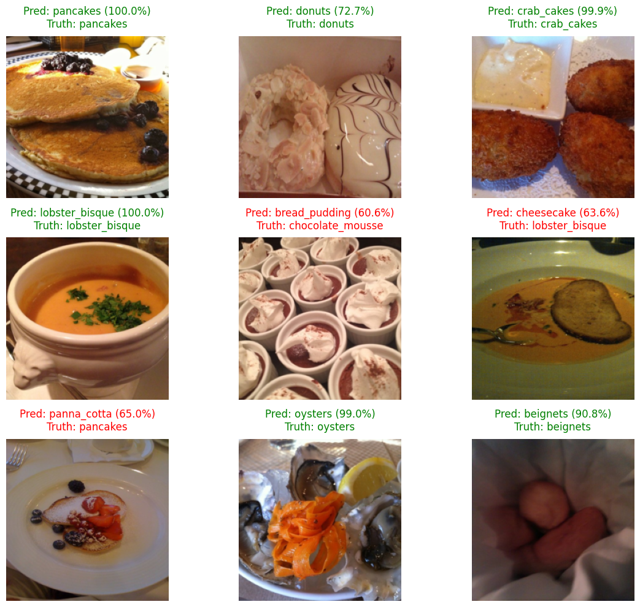
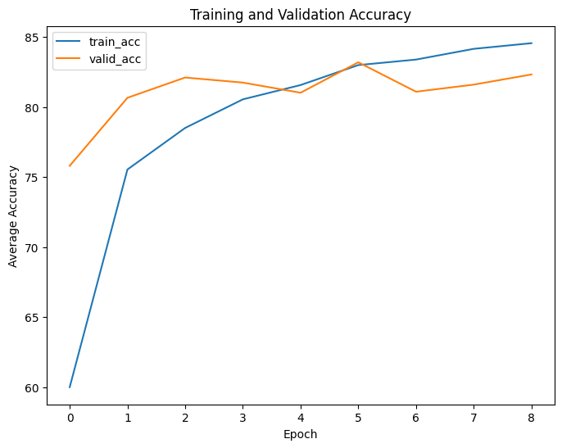
Experimental Results and Evaluation
3. Visual Validation
Most predictions show high confidence (70–95%)
Misclassifications mainly occur among visually similar dishes
Example: Pulao vs Fried Rice
Example: Dosa vs Uttapam
4. Key Insights
EfficientNet significantly outperforms VGG16/ResNet50 on both datasets
Data augmentation improves small dataset performance
Scheduling + Early Stopping prevents overfitting
Mixed-precision training reduces GPU usage by 40–50%

Slide 25
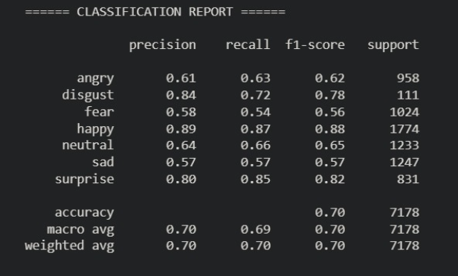
Experimental Results and Evaluation
MOOD RECOGNITION MODEL
Classification Report Highlights
Achieved strong recognition performance across major emotions AVERAGE ACCURACY - 70%
Best-performing classes: Happy, Surprise
Weak-performing classes: Fear, Sad (low samples, visually similar expressions)
High Precision & Recall for:
Happy (F1 = 0.88)
Surprise (F1 = 0.82)
Moderate performance for:
Neutral (F1 = 0.65)
Angry (F1 = 0.62)
Disgust (F1 = 0.78 but low support)
Low performance for:
Sad (F1 = 0.57)
Fear (F1 = 0.56)
Reason: Dataset imbalance + facial ambiguity
(similar expressions like Sad–Fear, Sad–Neutral).

Slide 26
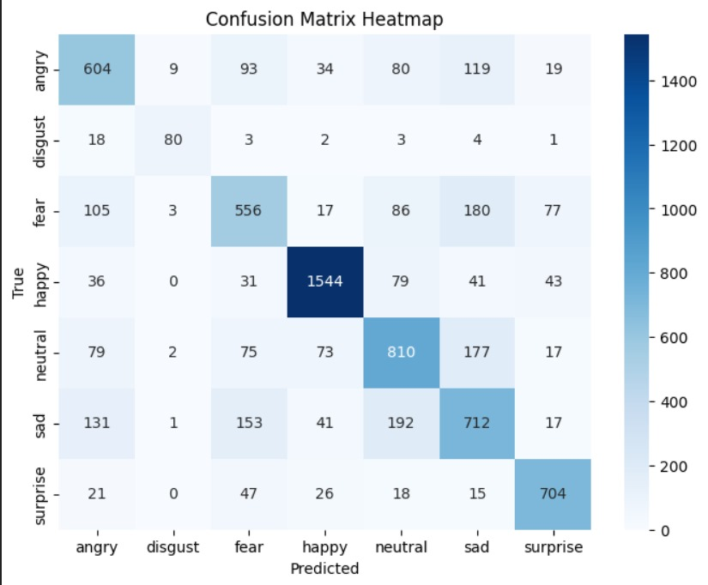
Experimental Results and Evaluation
2. Confusion Matrix Insights
Majority of predictions lie along the diagonal → strong learning
Common misclassifications:
Fear → Sad (very high: 180 cases)
Sad → Fear (153 cases)
Sad ↔ Neutral (192, 177)
Fear ↔ Surprise (77, 47)
Reasons:
Overlapping facial features
Low resolution of FER-2013 images

Slide 27
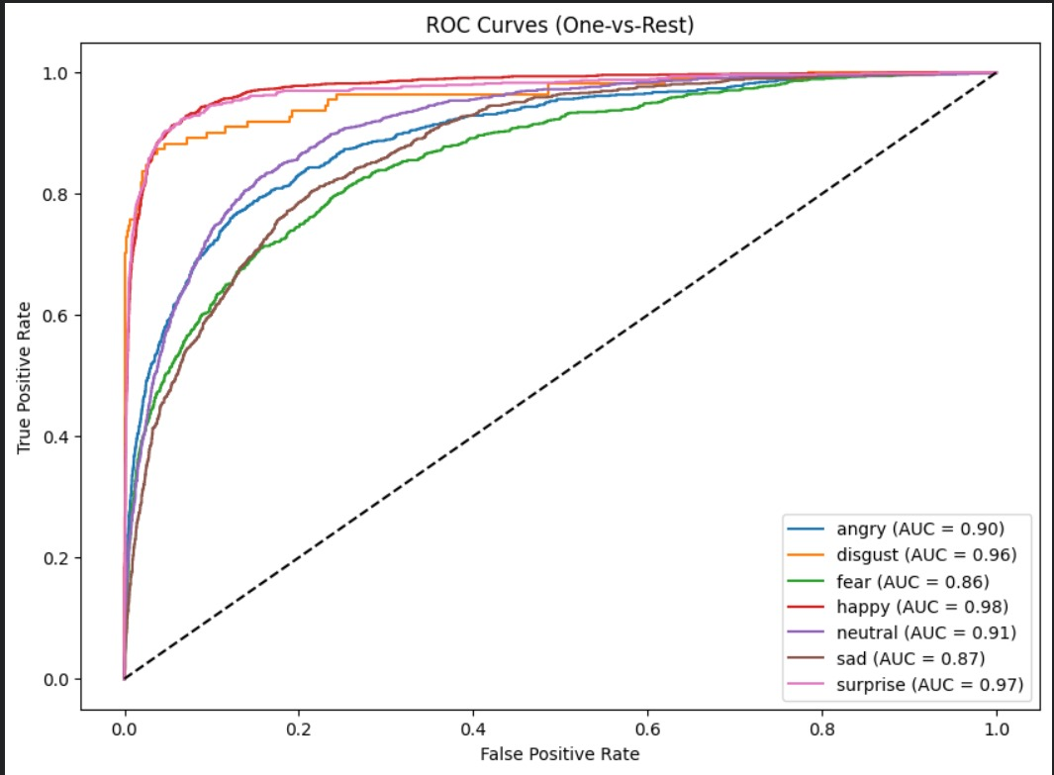
Experimental Results and Evaluation
3. ROC Curve Summary
All emotion classes achieved AUC > 0.85.
Disgust: ~0.96 (highest separability).
Fear: ~0.86 (good performance despite fewer samples).
Other classes also showed strong discrimination
above 0.85.
ROC results confirm robust and reliable
emotion classification.

Slide 28
Key Learnings
Gained experience in creating a dataset from scratch by combining primary data (Google Form responses) with secondary data (online sources).
Faced issues like missing/inconsistent entries, data imbalance, and merging formatS.
Data quality matters more than model complexity : low-resolution FER-2013 images limited expression clarity, proving that even strong architectures need high-quality inputs.
Augmentation is essential, not optional : aggressive augmentation significantly improved robustness, especially for real-world images with lighting and angle variations.
Class imbalance directly shapes model behavior : minority emotions (Disgust, Fear) showed weak raw accuracy but still achieved high AUC after weighted training.
Feature overlap between emotions is a fundamental ML challenge : emotions like Fear–Surprise and Sad–Neutral frequently overlap, showing limits of pixel-only learning.
EfficientNet-B0 strikes the best balance : faster training, stable gradients, and strong feature extraction made it superior to heavier CNNs for facial emotion tasks.

Slide 29
Work Contribution and Attendance
GitHub Repository URL: https://github.com/Mlakshay01/YOU2.O-MAJOR-PROJECT
Team Member | Roll No. | Work Done (provide complete details) | Work Contribution (%) | Lines of Code (if any) | Lab Attendance (%)
1. | 221030140 | Circulated the google form for dataset to the faculty and family members. Did Research work and literature survey for the project Worked on the Food Detection Model using Food 101 and IndianFood16 dataset. | 33.3% | 975 | 100%
2. | 221030249 | Circulated the google form for dataset to family members. Done data cleaning and made dataset ready for project use Did Research work and literature survey for the project | 33.3% |  | 100%
3. | 221030022 | Created the google form for dataset and circulated it. Did Research work and literature survey for the project. Built and evaluated the Mood Recognition Model. | 33.3% | 218 | 100%

Slide 30
Supervisor Interactions (as mentioned in weekly log)
No. of Meetings with Supervisor:
Week No. | Duration | Remarks (as mentioned in the weekly log) | Incorporated (Yes/No)
1. | 21/8/2025 to 24/8/2025 | Topic discussion
2. | 25/8/2025 to 28/8/2025 | Come up with research paper Research about the topic what and how it is to be done what technology and tools are already available | Yes
3. | 15/9/2025 to 17/9/2025 | Start a survey on dataset Keep in mind all the parameters | Yes
4. | 18/9/2025 to 20/9/2025 | Look for online dataset Merge them for better accuracy | Yes
5. | 22/9/2025 to 24/9/2025 | Do data preprocessing and cleaning Dataset is good | Yes
6. | 25/9/2025 to 27/9/2025 | Make changes in ppt and report as directed | Yes

Slide 31
Supervisor Interactions (as mentioned in weekly log)
No. of Meetings with Supervisor:
Week No. | Duration | Remarks (as mentioned in the weekly log) | Incorporated (Yes/No)
7. | 01/10/2025 to 07/10/2025 | Work on both dataset Start data preprocessing | Yes
8. | 28/10/2025 to 03/11/2025 | Do unit standardization Nutrient Scaling and normalization | Yes
9. | 04/10/2025 to 07/11/2025 | Start working on training of dataset Train the model | Yes
10. | 08/10/2025 to 10/11/2025 | Start working on mood recognition | Yes
11. | 11/10/2025 to 13/11/2025 | Train model and work on accuracy | Yes
12. | 14/11/2025 to 18/11/2025 | Start working on report | Yes

Slide 32
Future Work
Multi-Modal Inputs Combine images with text/ingredients for more accurate predictions.
Mobile Deployment Optimize model for real-time use in mobile/edge devices.
Portion & Calorie Estimation Use depth/volume estimation for precise nutrition prediction.
Personalization Adapt recommendations based on user habits, goals, and preferences.
Integration with Wearables/IoT Sync with smartwatches and health apps for holistic tracking.

Slide 33
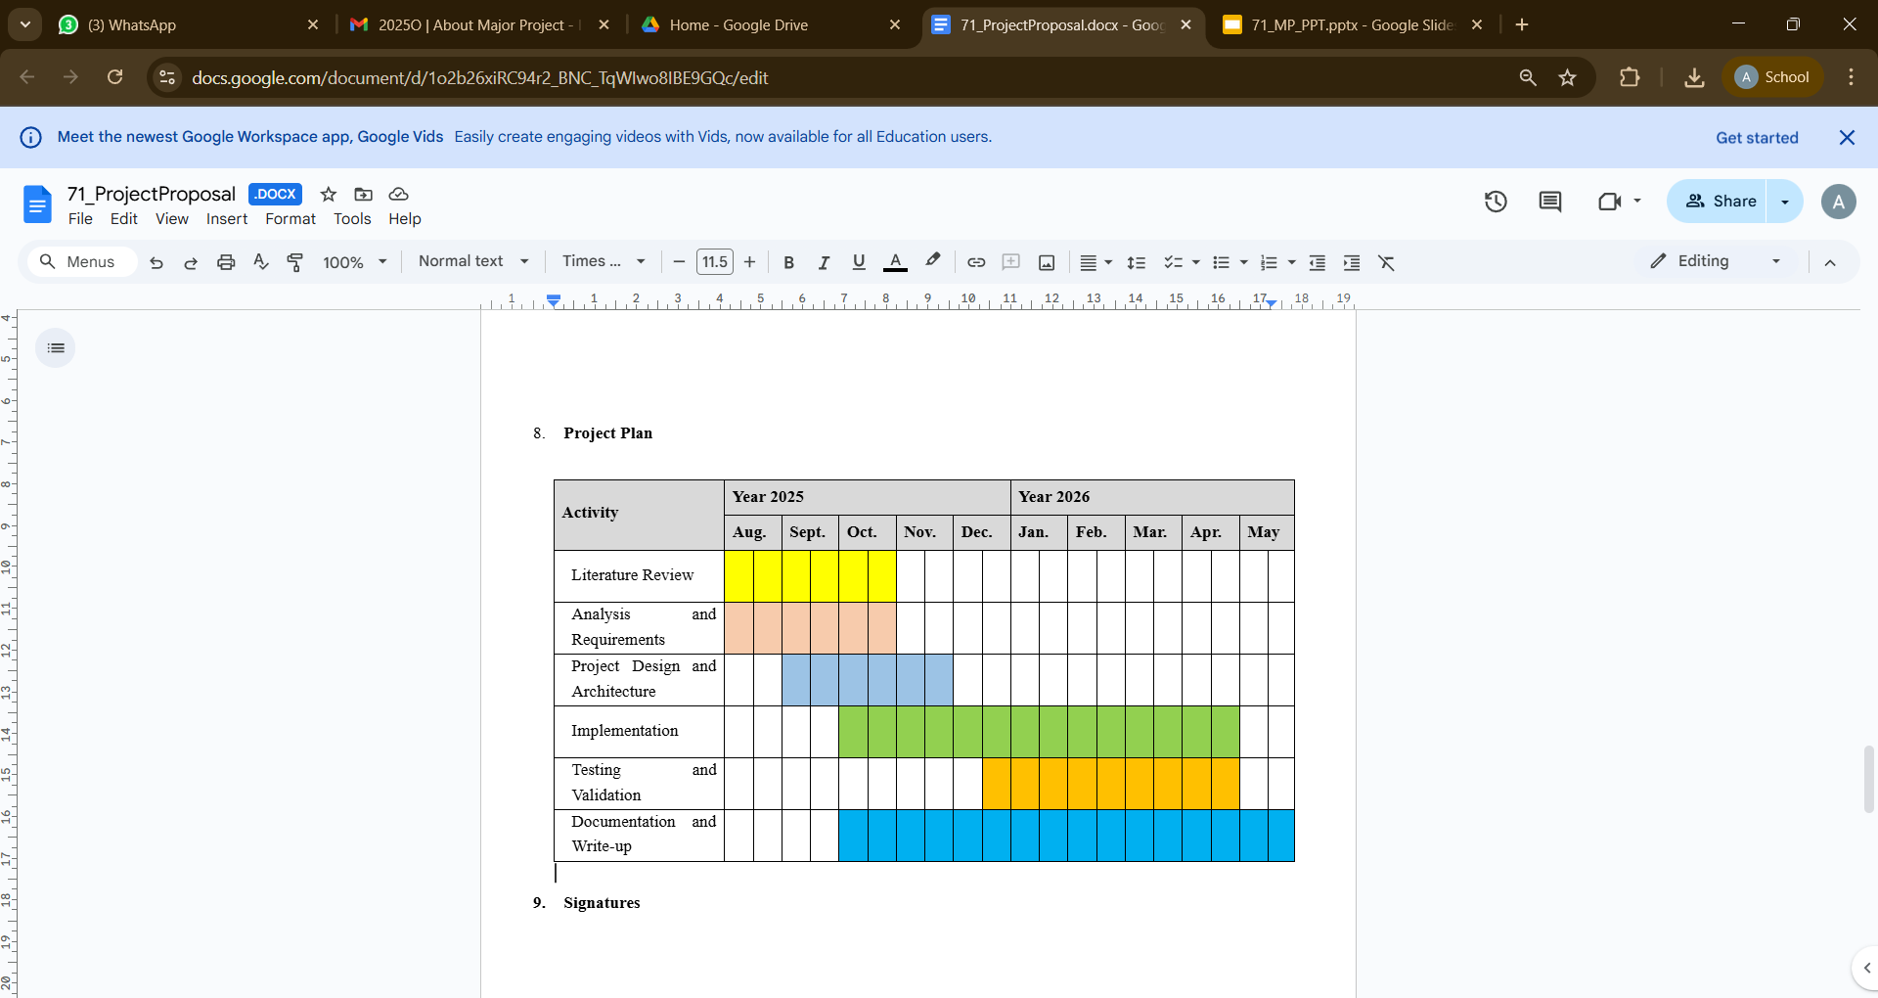
Project Plan

Slide 34
References
[1] J. Chiam, M. Zhang, and L. Wee, “Co-Pilot for Health: Personalized Algorithmic AI Nudging to Improve Health . preprint arXiv:2401.10816, 2024. [Online].Available: https://arxiv.org/abs/2401.10816
[2] R. Zahedani, et al., “AI-Based, Autonomous, Digital Health Intervention Using Precise Lifestyle Guidance on Blood Pressure in Adults With Hypertension,” JMIR Cardio, vol. 8, no. 1, p. e51916, 2024. [Online]. Available: https://cardio.jmir.org/2024/1/e51916
[3] P. Stolfi, G. Manco, and L. Tagliaferri, “Use of Non-Invasive Parameters and Machine Learning Algorithms for Predicting Future Risk of Type 2 Diabetes,” BMC Bioinformatics, vol. 21, no. 1, pp. 1–14, 2020. [Online]. Available: https://doi.org/10.1186/s12859-020-3415-9
[4] K. G. Deterding and N. Johnson, “The Effectiveness of Gamification in Changing Health-Related Behaviors: Systematic Review & Meta-analysis,” BMC Public Health, vol. 24, no. 3, pp. 451–467, 2024.
[5] A. Subramanian and H. Rahmani, “Applying AI in the Context of the Association Between Device-Based Assessment of Physical Activity and Mental Health: Systematic Review,” JMIR mHealth and uHealth, vol. 13, no. 1, p. e59660, 2025. [Online]. Available: https://mhealth.jmir.org/2025/1/e59660
[6] R. Zahedani, A. Wadhawan, and E. Fernandez, “Digital Health Application Integrating Wearable Data and Continuous Glucose Monitoring to Deliver Lifestyle Recommendations,” npj Digital Medicine, vol. 6, no. 4, pp. 1–12, 2023. [Online]. Available: https://doi.org/10.1038/s41746-023-00735-8
[7] Straczkiewicz et al., “A Systematic Review of Smartphone-Based Human Activity Recognition Methods for Health Research,” 2020. Review: Summarizes activity recognition techniques using smartphones. Highlights accuracy and reliability challenges across varied user behaviors and devices.

Slide 35
References (cont…)
[8] Kundu et al., “Smartphone-Based Human Activity Recognition Irrespective of Usage Behavior Using Deep Learning Technique,” 2021. Review: Proposes robust deep learning methods to recognize activity regardless of phone placement, improving real-world applicability.
[9] Wang et al., “The Impact of Gamification-Induced Users’ Feelings on the Continued Use of mHealth Apps: A Structural Equation Model With the Self-Determination Theory Approach,” 2020. Review: Shows gamification enhances motivation and retention in health apps, emphasizing user psychology for sustained engagement.
[10] Hwang et al., “Research Trends on Mobile Mental Health Application for General Population: A Scoping Review,” 2022. Review: Identifies trends in mental health apps; notes gaps in personalization and integration with healthcare systems.
[11] Almuqrin et al., “Smartphone Apps for Mental Health: Systematic Review of the Literature and Five Recommendations for Clinical Translation,” 2021. Review: Highlights clinical translation challenges and emphasizes evidence-based app design for real-world efficacy.
[12] Gemesi et al., “Efficacy of an App-Based Multimodal Lifestyle Intervention on Body Weight in Persons with Obesity: Results from a Randomized Controlled Trial,” 2021. Review: Validates app-based interventions for weight loss; underlines the importance of personalized recommendations.
[13] Birhanu et al., “A Mobile Health Application Use Among Diabetes Mellitus Patients: A Systematic Review and Meta-Analysis,” 2022. Review: Demonstrates the effectiveness of mobile apps in improving glucose control and adherence in diabetic patients.

Slide 36
References (cont…)
[14] H. S. Saad, J. F. W. Zaki, and M. M. Abdelsalam, “Employing of machine learning and wearable devices in healthcare system: tasks and challenges,” Neural Computing and Applications, vol. 36, pp. 17829–17849, Aug. 2024. Available: 10.1007/s00521-024-10197-z
[15]M. N. Islam, S. M. A. Shima, A. S. M. J. Uddin, and J.-M. Kim, “Deep learning based wearable real-time heart attack detection system,” Scientific Reports, vol. 11, no. 1, p. 17714, Sept. 2021. Availablei: 10.1038/s41598-021-96938-3
[16]H. Habehh and S. Gohel, “Machine learning in healthcare,” Current Genomics, vol. 22, no. 4, pp. 291–300, 2021. Available: 10.2174/1389202922666210705124359
[17] A. Logacjov, E. S. Skarpsno, A. Kongsvold, K. Bach, and P. J. Mork, “A Machine Learning Model for Predicting Sleep and Wakefulness Based on Accelerometry, Skin Temperature and Contextual Information,” Nature and Science of Sleep, vol. 16, pp. 699–710, 2024. [Online]. Available: https://doi.org/10.2147/NSS.S452799
[18] Q. An, S. Rahman, J. Zhou, and J. J. Kang, “A Comprehensive Review on Machine Learning in Healthcare Industry: Classification, Restrictions, Opportunities and Challenges,” Sensors, vol. 23, p. 4178, 2023. [Online]. Available: https://doi.org/10.3390/s23094178
[19] T. P. T. Armand, K. A. Nfor, J.-I. Kim, and H.-C. Kim, “Applications of Artificial Intelligence, Machine Learning, and Deep Learning in Nutrition: A Systematic Review,” Nutrients, vol. 16, no. 7, p. 1073, 2024. [Online]. Available: https://doi.org/10.3390/nu16071073
[20] R. Yera, A. A. Alzahrani, L. Martínez, and R. M. Rodríguez, “A Systematic Review on Food Recommender Systems for Diabetic Patients,” International Journal of Environmental Research and Public Health, vol. 20, no. 5, p. 4248, 2023. [Online]. Available: https://doi.org/10.3390/ijerph20054248

Slide 37

Thanks.

